Slide 1
AC OVER &UNDER VOLTAGE PROTECTION
Dr Tarek Elewa.
Shubra Faculty of Engineering

Slide 2
Table of contents
01
02
03
04
Introduction
Explain the project
Describe the project and understand the operation of it
What is the Over & under Voltage and how to protect our applications from it
Analysis Circuit
Conclusion
Understand the Schematic of our project
The final of our report

Slide 3
Describe the project and understand the operation of it
Introduction

Slide 4
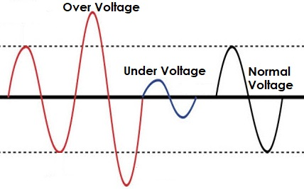
Introduction
In this project, we will make a smart Arduino based AC Voltage protection With Under & Over Voltage Protection Features
Nowadays there are a lot of AC Mains voltage fluctuations due to interruption of heavy load, thunder & lightning, and switching impulses. This can easily damage the electronics/electrical parts and sometimes lead to fire accidents. Voltage irregularities are the major issues in industries that often damage sensitive electronic equipment. In most cases, MCB is used as a protection system but it would be better if we implement our own system which could be cheaper and more advanced. Moreover, the system should have user input for under-voltage and over-voltage protection .

Slide 5
Introduction
Many devices are available in the market for AC Voltage Monitoring along with Under, Normal & Over Voltage Protection features. But they are expensive and can’t have user input. This project aims to sort out all those drawbacks and develop protection & monitoring for the electrical equipment from over and under AC voltages using Arduino as a controller at a low cost. We use Arduino to measure AC Voltage and based on under & over voltage detection, the Relay can turn off the entire system.

Slide 6
What is Over Voltage & Under Voltage?
Over voltages are the voltages that exceed the normal or rated values which cause insulation damage to electrical appliances leading to short circuits. To be more precise, it’s when a supply voltage of 10 percent and above the rated voltage occurs. The conditions may be hazardous. Depending on its duration, the overvoltage event can be transient—a voltage spike—or permanent, leading to a power surge.
Similarly, Undervoltage happens when the average voltage of equipment falls below the rated voltage amount. Frequent Undervoltage can result in a degradation in equipment performance and reliability.

Slide 7
Our Components
Arduino UNO
Generator
Voltameter
UP-Down Transformer
Relay
Capacitors
Resistors (3of 100KOhm & 1 of 10KOhm)
LCD 20*4
Led and Lamp

Slide 8
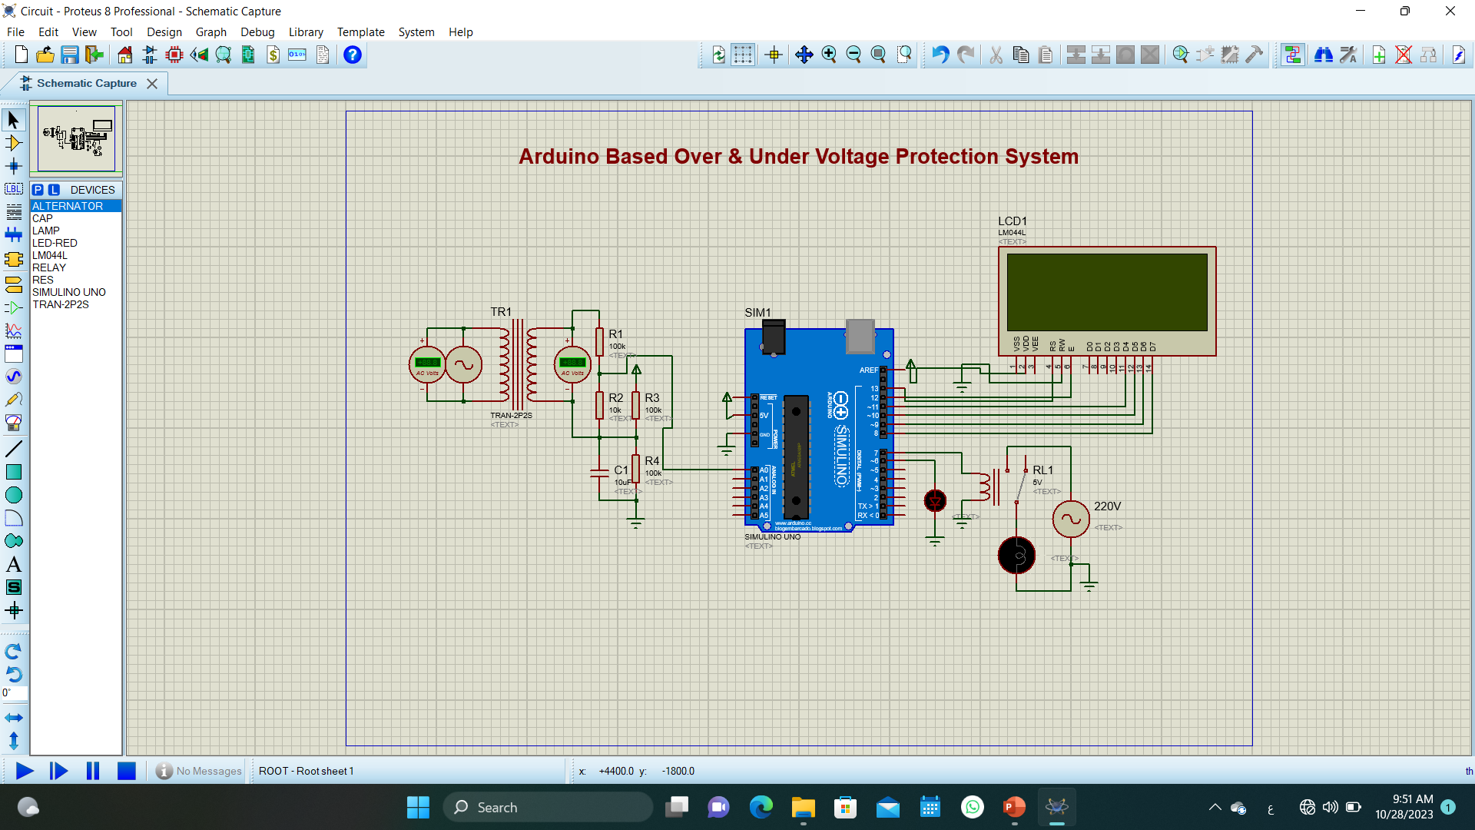
Circuit Diagram: Arduino Over & Under AC Voltage Monitoring

Slide 9
Circuit Diagram: Arduino Over & Under AC Voltage Monitoring
First we have a Generators to Produce AC Voltage
Use UP-Down Transformer to Decrease our Voltage
We apply The output voltage on resistors To enable us to apply it on Arduino
Arduino connected with 5V and GND
Arduino reads the voltage through pin A0 which is on resistor
Then it applying The code we Upload on it.
Relay will be controlled by Arduino (ON, OFF).
The Red Led will be on if Under and Over voltage occurs.
The LCD will display the state of the voltage (Over, Normal and Under) and Vrms value

Slide 10
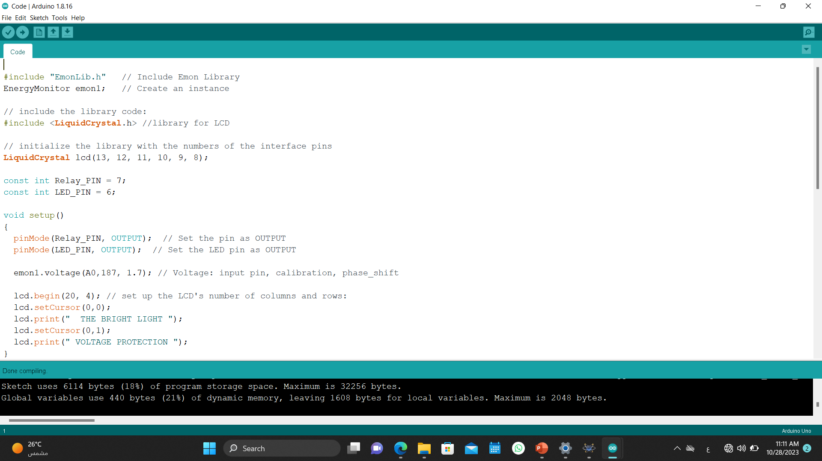
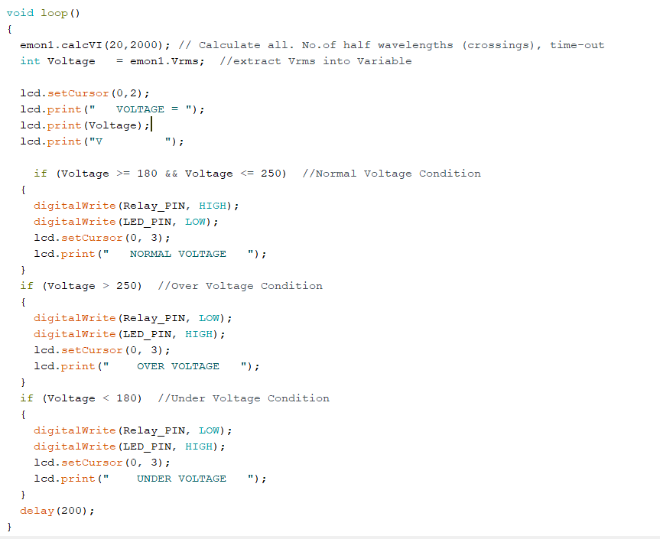
Circuit Code: Arduino Over & Under AC Voltage Monitoring

Slide 11
Thanks !
Habiba Mahmoud
Habiba Ahmed
Bosina Saad
Salma Bahaa
Yasmeen Essam
Aya Mohamed

